Slide 1
Big Data

Slide 2
The term ______ is used to denote a unit of storage that can store one or more records
a) Basket
b) Bucket
c) Unit
d) Set
Notes:
b

Slide 3
If K denotes the set of all the search key values, and B denotes the set of all bucket addresses, a function from K to B is called as __________
a) Bucket function
b) Address function
c) Hash function
d) Search function
Notes:
C
If K denotes the set of all the search key values, and B denotes the set of all bucket addresses, a function h from K to B is called as the hash function. It determines which bucket should contain the data in question.

Slide 4
What is a bucket overflow?
a) When a bucket does not have enough space
b) There are insufficient buckets
c) When Bucket skew occurs
d) All of the mentioned
Notes:
D
Some buckets are assigned more records than are others, so a bucket may overﬂow even when other buckets still have space. This situation is called bucket skew.

Slide 5
Dynamic hashing is also called as _________
a) Extended hashing
b) Extendable hashing
c) Static hashing
d) Movable hashing
Notes:
b

Slide 6
Big data
'Big Data' is also a data but with a huge size.
'Big Data' is a term used to describe collection of data that is huge in size and yet growing exponentially with time.
In short, such a data is so large and complex that none of the traditional data management tools are able to store it or process it efficiently.

Slide 7
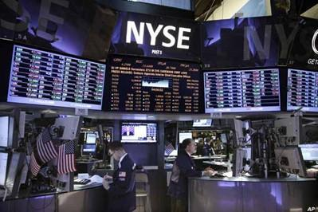
Examples Of 'Big Data'
The New York Stock Exchange generates about one terabyte of new trade data per day.

Slide 8

Social Media Impact
Statistic shows that 500+terabytes of new data gets ingested into the databases of social media site Facebook, every day.
This data is mainly generated in terms of photo and video uploads, message exchanges, putting comments etc.

Slide 9

Single Jet engine can generate 10+terabytes of data in 30 minutes of a flight time. With many thousand flights per day, generation of data reaches up to many Petabytes.

Slide 10
Categories Of 'Big Data'
Big data' could be found in three forms:
Structured
Unstructured
Semi-structured

Slide 11
Structured
Any data that can be stored, accessed and processed in the form of fixed format is termed as a 'structured' data.
Employee_ID | Employee_Name | Gender | Department | Salary_In_lacs
2365 | Rajesh Kulkarni | Male | Finance | 650000
3398 | Pratibha Joshi | Female | Admin | 650000
7465 | Shushil Roy | Male | Admin | 500000
7500 | Shubhojit Das | Male | Finance | 500000
7699 | Priya Sane | Female | Finance | 550000

Slide 12
Unstructured
Any data with unknown form or the structure is classified as unstructured data.
In addition to the size being huge, un-structured data poses multiple challenges in terms of its processing for deriving value out of it.
Typical example of unstructured data is, a heterogeneous data source containing a combination of simple text files, images, videos etc.
Now a day organizations have wealth of data available with them but unfortunately they don't know how to derive value out of it since this data is in its raw form or unstructured format.

Slide 13
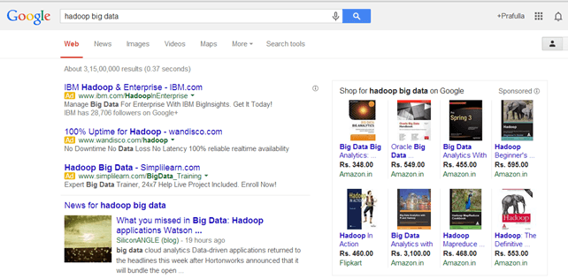
Examples Of Un-structured Data
Output returned by 'Google Search‘

Slide 14
Semi-structured
Semi-structured data can contain both the forms of data.
We can see semi-structured data as a structured in form but it is actually not defined with e.g. a table definition in relational DBMS.
Semi-structured data is information that doesn’t reside in a relational database but that does have some organizational properties that make it easier to analyze.
Example of semi-structured data is a data represented in XML file.

Slide 15
Characteristics Of 'Big Data'
Also called 3Vs of Big Data
Volume
Variety
Velocity
Now a days, 2 more Vs are added to the characteristics of Big data i.e. Veracity and Value.

Slide 16
1. Volume
The name 'Big Data' itself is related to a size which is enormous.
Size of data plays very crucial role in determining value out of data.
Also, whether a particular data can actually be considered as a Big Data or not, is dependent upon volume of data.
Hence, 'Volume' is one characteristic which needs to be considered while dealing with 'Big Data'.

Slide 17
2. Variety
The next aspect of 'Big Data' is its variety.
Variety refers to heterogeneous sources and the nature of data, both structured and unstructured.
During earlier days, spreadsheets and databases were the only sources of data considered by most of the applications.
Now days, data in the form of emails, photos, videos, monitoring devices, PDFs, audio, etc. is also being considered in the analysis applications.
This variety of unstructured data poses certain issues for storage, mining and analysing data.

Slide 18
3. Velocity
The term 'velocity' refers to the speed of generation of data.
How fast the data is generated and processed to meet the demands, determines real potential in the data.
Big Data Velocity deals with the speed at which data flows in from sources like business processes, application logs, networks and social media sites, sensors, Mobile devices, etc.
The flow of data is massive and continuous.

Slide 19
Benefits of Big Data Processing
Smarter Healthcare
Traffic Control
Manufacturing
Multi-channel sales
Telecom
Trading Analytics
Search Quality

Slide 20
NoSQL
NoSQL is an approach to database design that can accomodate a wide variety of data models, including key-value, document, columnar and graph formats.
NoSQL, which stand for "not only SQL," is an alternative to traditional relational databases in which data is placed in tables and data schema is carefully designed before the database is built.
NoSQL databases are especially useful for working with large sets of distributed data.

Slide 21
Major issues of Relational Databases
Relational databases were designed for tabular data, with a consistent structure and a fixed schema. They work best for problems that are well defined at the outset. But not good to manage unstructued data.
A Large Number of JOINs
When you utilize queries that join many different tables, there’s an explosion of complexity and computing resource consumption. This results in a corresponding increase in query response times.
Frequent Schema Changes
Slow-Running Queries

Slide 22
Characterisics of NoSQL
It’s more than rows in tables—NoSQL systems store and retrieve data from many formats: key-value stores, graph databases, column-family stores, document stores, and even rows in tables.
It’s free of joins—NoSQL systems allow you to extract your data using simple interfaces without joins.
It’s schema-free—NoSQL systems allow you to drag-and-drop your data into a folder and then query it without creating an entity-relational model.
It works on many processors—NoSQL systems allow you to store your database on multiple processors and maintain high-speed performance.
It supports linear scalability—When you add more processors, you get a consistent increase in performance.

Slide 23
Data Models of NoSQL
Key-value data model
Document data model
Column Family data model
Graph data model

